Slide 1
Textput
The text summarizer.

Slide 2
About textput
So textput is text summarizer which provides:
The summary of the text
Sentimental analysis
Latest news about the topic of the text
Technology used is Django and python for development

Slide 3
Major Advantages
Works Instantly
Reading the entire article, dissecting it and separating the important ideas from the raw text takes time and effort. But summarizer does it in seconds.
Improve productivity
Not only the text in documents but the text in web pages also summarized like news article which also have some useless information

Slide 4
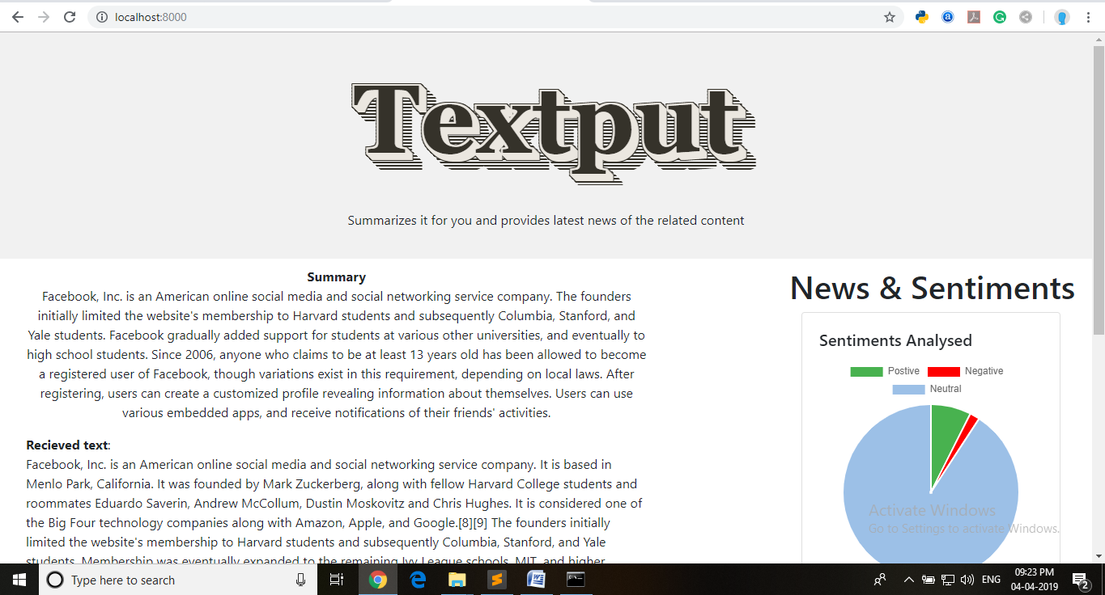
View of textput

Slide 5
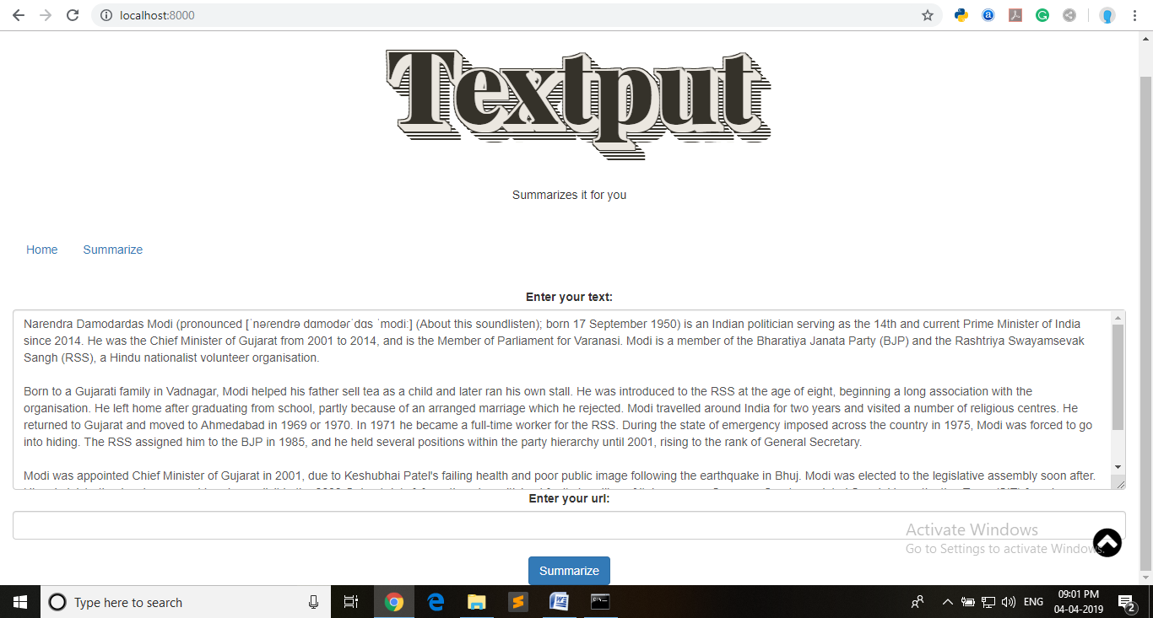
Text input

Slide 6
About summary
There are 2 fields for input
First is a plane text field where you can enter your text and click for summarization
Second is the URL field which is used to give the URL of the text source.
Then the text will be analysed and a summary will be generated out of it.

Slide 7
About type of summarization
Extractive
Source text: Joseph and Mary rode on a donkey to attend the annual event in Jerusalem. In the city, Mary gave birth to a child named Jesus.
Extractive summary: Joseph and Mary attend event Jerusalem. Mary birth Jesus.

Slide 8
About type of summarization
Extractive
Source text:
Joseph and Mary rode on a donkey to attend the annual event in Jerusalem. In the city, Mary gave birth to a child named Jesus.
Extractive summary:
Joseph and Mary came to Jerusalem where Jesus was born.

Slide 9
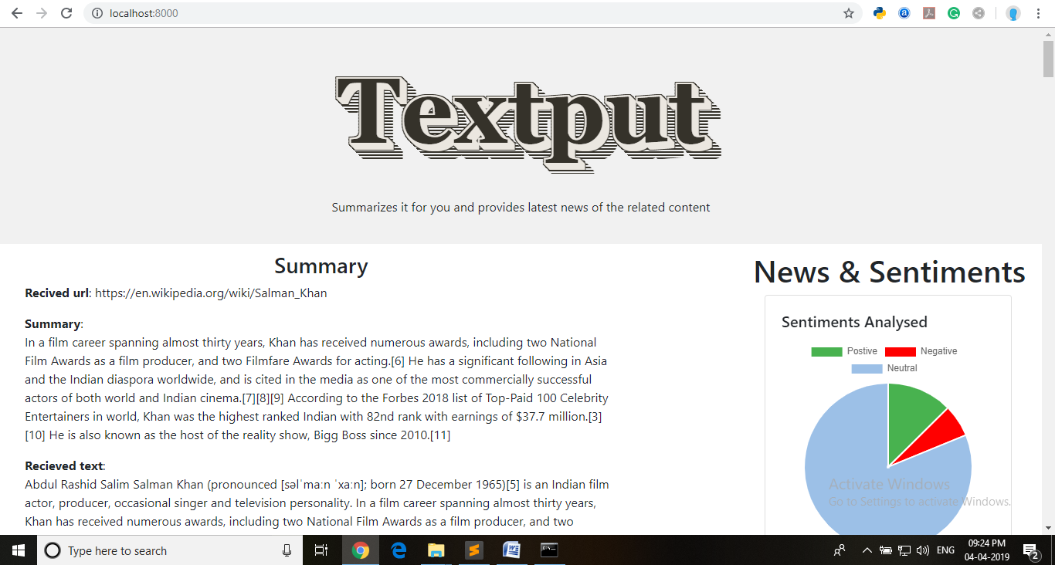
Summary

Slide 10
About Sentimental Analysis
The text will be extracted from input field
And the Sentimental analysis will be according to the text provided.

Slide 11
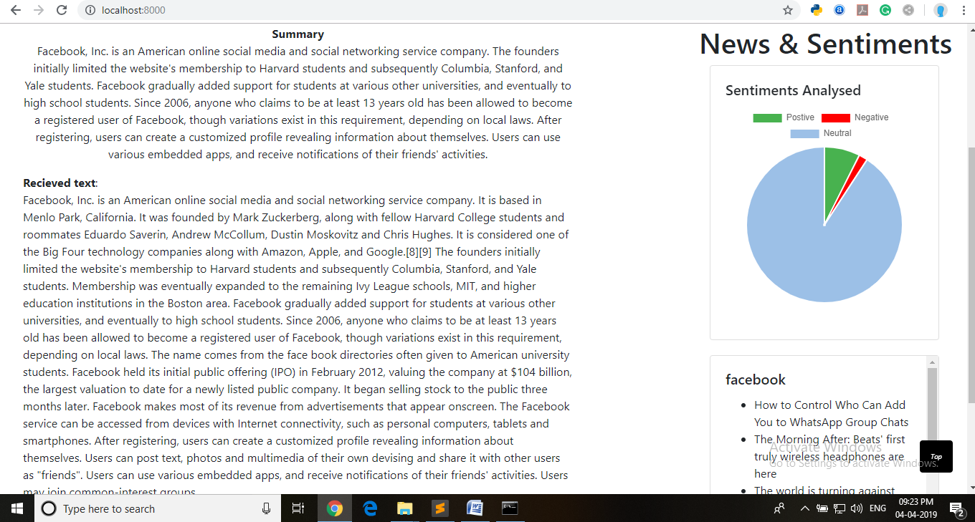
Sentiments

Slide 12
About News
The Summarized text will be analysed for the News .
Process behind it is like extracting the nouns from the text and sending it via news API for getting the latest news.

Slide 13
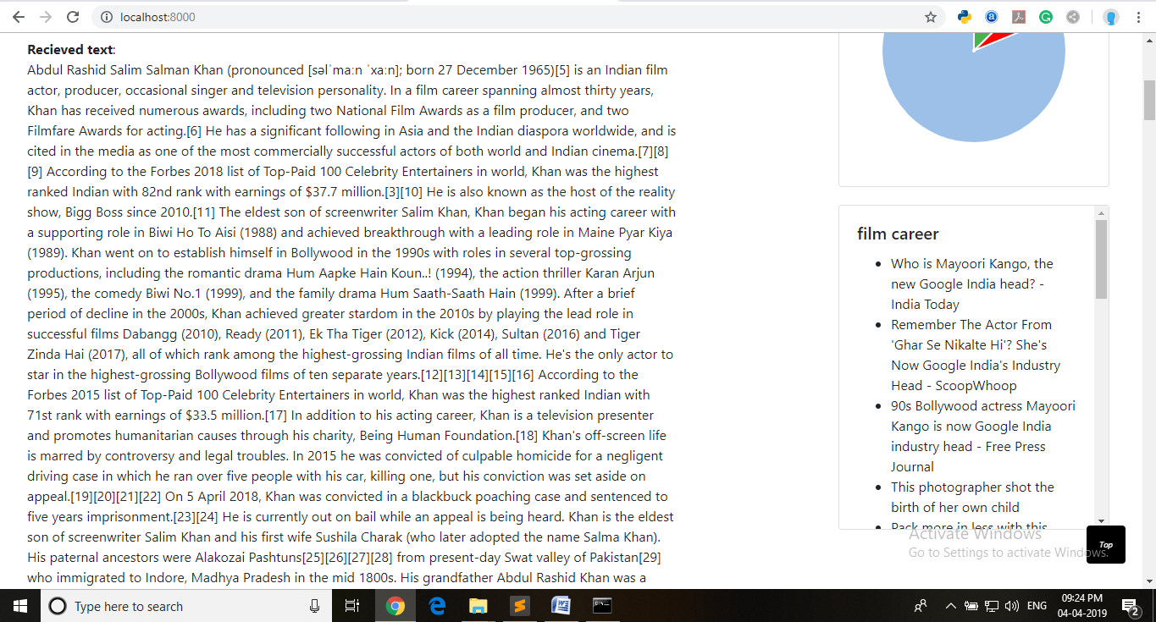
News Section

Slide 14
Thank You

